Slide 1

CPQ – Asia Alignment Design and Mock Up Dec ‘19
Colt confidential

Slide 2

Document Release and Change Log Details
CPQ Asia
Version Number | 0.3
Date | 26th Nov, 2019
Change log | Discounting and deal governance Slide updates after internal review

Slide 3
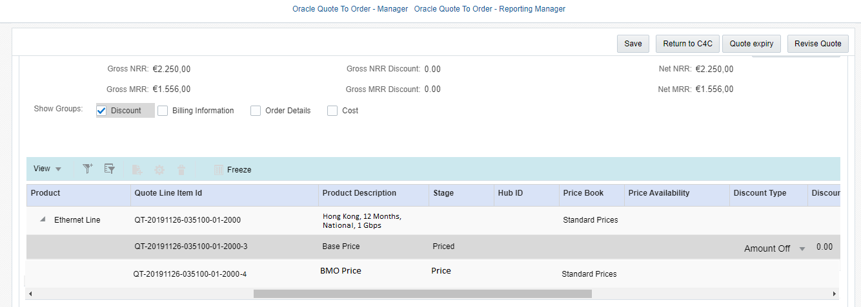
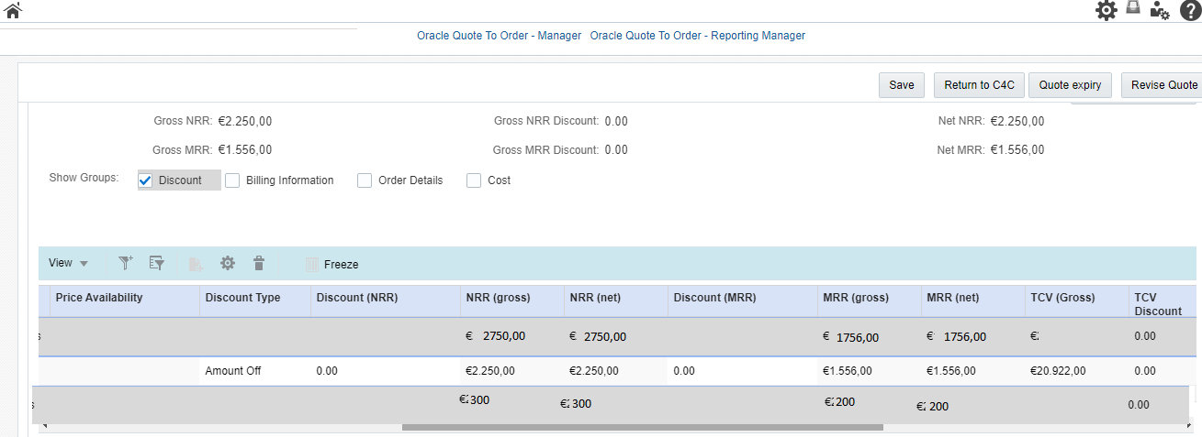
CPQ Asia: BMO Discounting
Sales user should not be able to discount the BMO charges
The discounting option would be disabled during the discounting journey
The net and gross values should be shown same to user for BMO charges

Slide 4
CPQ Asia : Discounting and Deal Governance
Email notifications to commercial operations team Asia based on the Colt Org Country (JP,HK,SG,SK)
Separate views for commercial operations team Asia and deal pricing team Europe in Transaction manager in CPQ

Slide 5
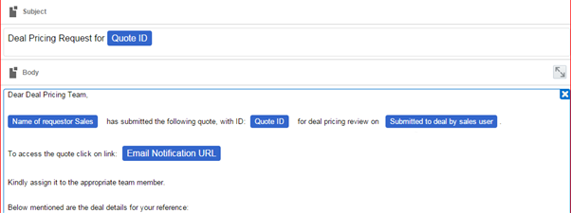
CPQ Asia : Email notifications
Sample Notification to deal pricing team
Deal pricing email notifications to be triggered to appropriate team based on the Colt Org Countries
Deal pricing email notification for Asia will go to ‘GS-Pricing@colt.net’

Slide 6
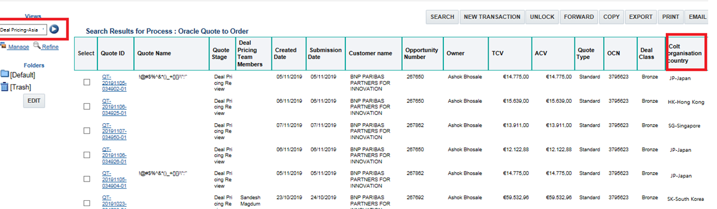
CPQ Asia : Transaction Manager View
All deal pricing requests for the quotes where colt org country is Asia (JP,HK,SG,SK) will be sent to commercial operations team
A separate transaction manager view will be created for commercial operations team based on the Colt Org country
Name of the View will ‘Deal Pricing Asia’. The existing deal pricing view would be renamed to ‘Deal Pricing EU’. Column required for ‘Deal Pricing Asia’ would exactly the same as the existing Deal Pricing Asia view.
All deal pricing users will have access to both Asia and EU views

Slide 7
CPQ Asia : MMT Changes
Areas where MMT changes are required for Asia requirements. All the below requirements are product agnostic .
BMO Charges for Hong Kong
One time Opex – CPQ/MMT currently supports recurring Opex
MMT Export Impact only:
Supplier Surcharge for Hong Kong – A flag to indicate that the base prices are elevated
If the Access Type = ULL Fibre , then CPQ should translate it to Colt Fibre in the Pricing export. While importing back the sheet from MMT into CPQ the Access Type column does not come back in the import sheet , hence no change .
Colt Fibre – Additional Charge Opex and Capex might get added. These will be mapped to base bespoke cost

Slide 8
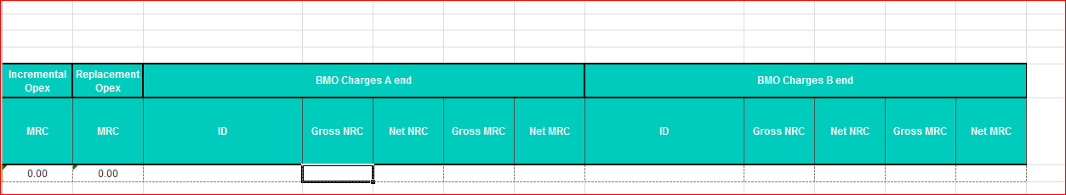
CPQ Asia : MMT Changes-BMO
BMO charges
New columns for BMO charges will be added in the pricing export templates for Ethernet Line, H&S, wave and IP Access
Charges will be at site-level.
No additional logic to be written in MMT to make these fields Asia specific
MMT should able to consume the BMO charges
MMT export should have BMO charges
Deal pricing team should not discount the BMO charges (Process)

Slide 9
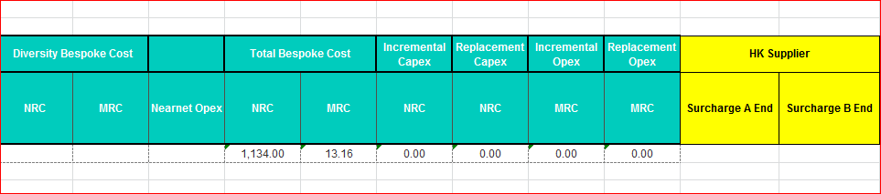
CPQ Asia : MMT Changes: Supplier Surcharge for Hong Kong
Supplier Surcharge
In case system applies supplier surcharge for Hong Kong sites then a flag should be send to MMT
This flag will indicate to the Deal pricing team the reason for elevated base charge
The name of the flag should be ‘HK Supplier Surcharge’
Charges will be at site-level.
MMT export sheet should be enhanced to accommodate this flag
MMT will not consume this flag
While importing back the sheet from MMT into CPQ this Flag will not come back in the import sheet ,
hence no change .

Slide 10
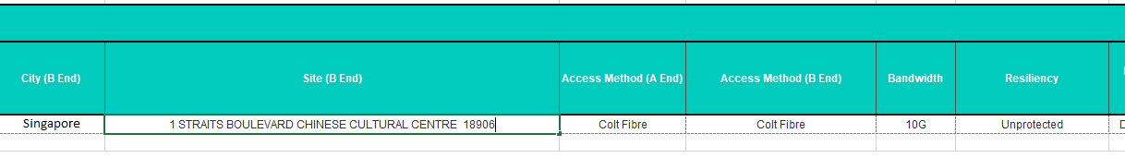
CPQ Asia: MMT: Access Type = ULL Fibre
If the Access Type = ULL Fibre, then CPQ should translate the access type to Colt Fibre in the MMT export.
This change is required for Ethernet Line, Ethernet Hub, Ethernet Spoke, Wave & IPAccess
While importing back the sheet from MMT into CPQ the Access Type column does not come back in the
import sheet , hence no change .

Slide 11
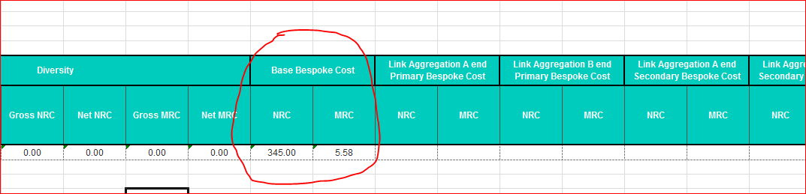
CPQ Asia : MMT Changes-Colt Fibre
Colt Fibre non-standard configuration
No new columns required in pricing export sheets for all products
Existing CAPEX,OPEX will be added in the Base price bespoke cost columns similar to non-standard interfaces

Slide 12
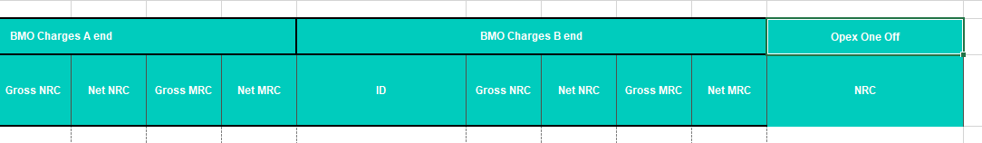
CPQ Asia : MMT Changes: One Time Opex
One Time Opex:
One time Opex should be available in CPQ for Bespoke and SE engagement journeys across all the applicable scenario
In the pricing export CPQ should do a summation of all the One time Opex present in the quote and populate the ‘One Time Opex’ field on pricing export

Slide 13
CPQ Asia: Governance Hierarchy post Deal Pricing Review
No Change
Once the Quote has been approved by deal pricing, the Governance Approval Hierarchy is determined by the profitability of the Deal (IGMAD %) & connectivity type of the Line model.
Sales and Finance Approval hierarchy for Asia will be aligned with EU
Data(On-net)
Data(Off-net/NearNet)
If all lines contain only on-net connections, the following thresholds apply:
If any line contains off-net or near-net connection, the following thresholds should apply instead:
Deal Class | Profitability (IGMAD) | Sales approver | Finance approver
Bronze+ or Silver | >= 30% | VP Sales – 2 | VP Finance – 2
 | < 30% and >= 25% | VP Sales – 1 | VP Finance – 1
 | < 25% | VP Sales | VP Finance
Gold | Any value | CRO | VP Finance
Platinum | Any value | CRO | VP Finance CFO
Deal Class | Profitability (IGMAD) | Sales approver | Finance approver
Bronze+ or Silver | >= 20% | VP Sales – 2 | VP Finance – 2
 | < 20% and >= 17% | VP Sales – 1 | VP Finance – 1
 | < 17% | VP Sales | VP Finance
Gold | Any value | CRO | VP Finance
Platinum | Any value | CRO | VP Finance CFO
Exception: If the quote is raised by a US Sales User, then the approvals are always routed to the “US Finance Approver” user (“Herve Jost”) and do not follow the above hierarchy

